Slide 1





Slide 2

The Empire Strikes Back Azure DocumentDB

Slide 3

Who I AM
{ name: “David Green”, twitter: “@davidjeet”, location: “Durham, NC”, company: “PeopleFluent”, favorite_database: “MongoDB”, favorite_language: “C#”, favorite_movie: “Umm…” }

Slide 4

Agenda
Introduction
Azure, NoSQL & DocumentDB
Getting Started (Setup in Azure)
Working with DocumentDB (C#)
Cost/usage
Uses cases & limitations of DocumentDB
You have your moments. Not many of them, but you do have them. ~ Princess Leia
Notes:
Sir, the possibility of successfully navigating an asteroid field is approximately 3,720 to 1.

Slide 5

(Redmond, WA ~ July 2014)
Notes:
Always be storytelling. The whole presentation needs to be a story…

Slide 6
The (Microsoft) Empire Strikes Back At long last, Microsoft speaks NoSQL. Redmond’s long awaited answer to the likes of MongoDB and RavenDB is the (still-in-preview) Azure DocumentDB database-as-a-service.
See how easy it is to create and configure a document database with the Azure Management Portal and immediately start to query its schema free data with familiar semantics that are common to relational database systems.
In this session we'll also take some time to look at some of DocumentDB's strengths/limitations, along with what scenarios make a good fit for using this product , and how DocumentDB stacks up against its competitors.
Notes:
Maybe a story about how the Empire needs a new database after the Rebels destroyed their only copy MS Access when they blew up the death star.
Maybe something in the cloud in case they blow up their next Death Star At least they have some redundancy/failover.
Some researchers claim to have invented something that might remedy the problem…

Slide 7


Slide 8


Agenda
Introduction
Azure, NoSQL & DocumentDB
Getting Started (Setup in Azure)
Working with DocumentDB (C#)
Cost/usage
Uses cases & limitations of DocumentDB
“You must unlearn what you have learned.” ~ Yoda
Notes:
You must unlearn what you have learned.

Slide 9

What is this Thing?
Product Name:
Azure Document DB
Pronunciation: azh-er dok-yuh-muh nt dee bee
Definition: A fully-managed, highly scalable NoSQL document database service.

Slide 10
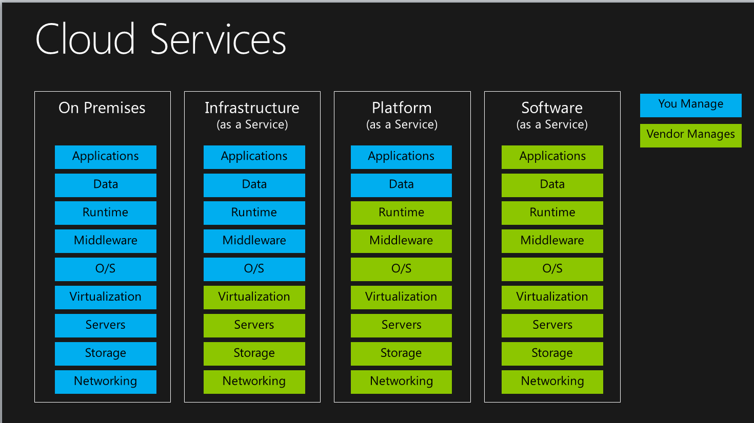
Azure DocumentDB A fully-managed, highly scalable NoSQL document database service.
DocumentDB

Slide 11
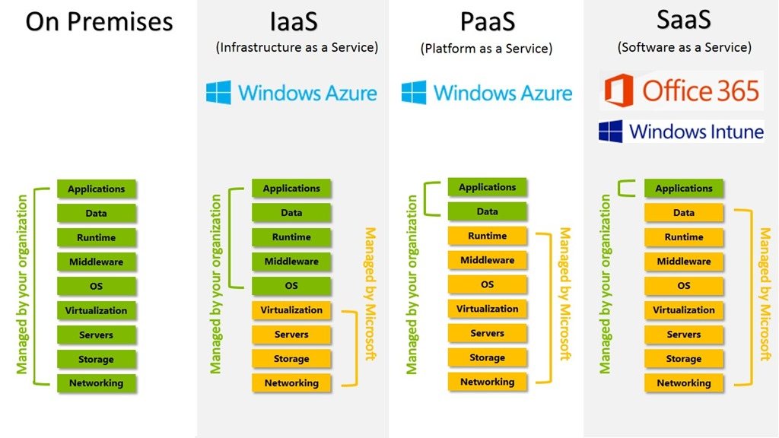

Azure DocumentDB A fully-managed, highly scalable NoSQL document database service.
DocumentDB woz ‘ere

Slide 12
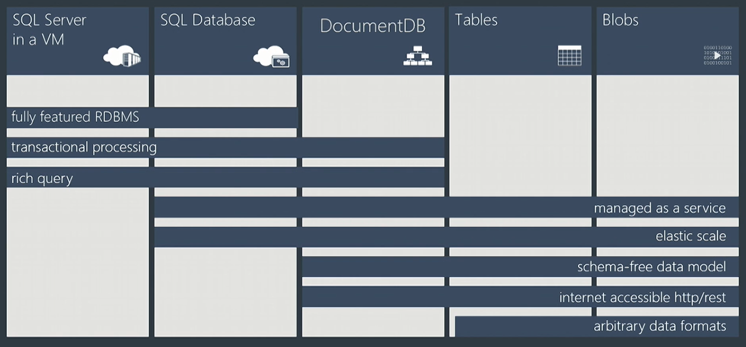
Azure DocumentDB A fully-managed, highly scalable NoSQL document database service.
Notes:
How many people have heard of the term pologlot programming? So these days what’s been popular for a while is this notion of polyglot data stores.n

Slide 13
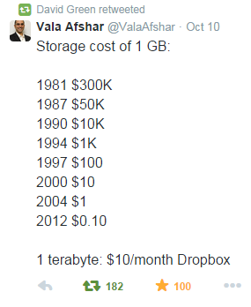
As the cost of storage has fallen, the viability of Polyglot database solutions is now a reality. ~ Me
Notes:
As the cost of storage has fallen, the viability of Polyglot database solutions is now a reality.

Slide 14


Azure DocumentDB A fully-managed, highly scalable NoSQL document database service.
But, by highly scalable we mean “horizontally scalable” (i.e. v. partition tolerant)
Vertical scaling = more RAM, faster CPU, etc.
Horizontally scaling = more low cost servers/virtual machines
“That’s no moon…” – Obi Wan Kenobi
Notes:
Maybe do an animation of a db growing
and then an animation of severaldbs appearing in stages
Remember to mention to te listener that in horizontal scale to the dev/clien
t it appears we are still hitting one database.

Slide 15
Azure DocumentDB A fully-managed, highly scalable NoSQL document database service.
Martin Fowler:* Some characteristics are common amongst these databases, but none are definitional.
Model not using the SQL language
Designed to run on large clusters
Not using the relational model
No schema enforced
Open source
* “NoSQL Distilled: A Brief Guide to the Emerging World of Polyglot Persistence”, Martin Fowler

Slide 16
Azure DocumentDB A fully-managed, highly scalable NoSQL document database service.
Columnar
Key-value
HBase
Cassandra
Hypertable
Redis
Riak
Memcached
Voldemort
DocumentDB
CouchDB
RavenDB
MongoDB
Neo4J
GiraffeDB
InfiniteGraph
Document
Graph
* Seven Databases in Seven Weeks, Eric Redmond and Jim R. Wilson
Notes:
This is important to know when I’m making comparisons. E.g. can’t compare this to Riak or Cassandra, better to compare to MongoDB, RavenDB.

Slide 17
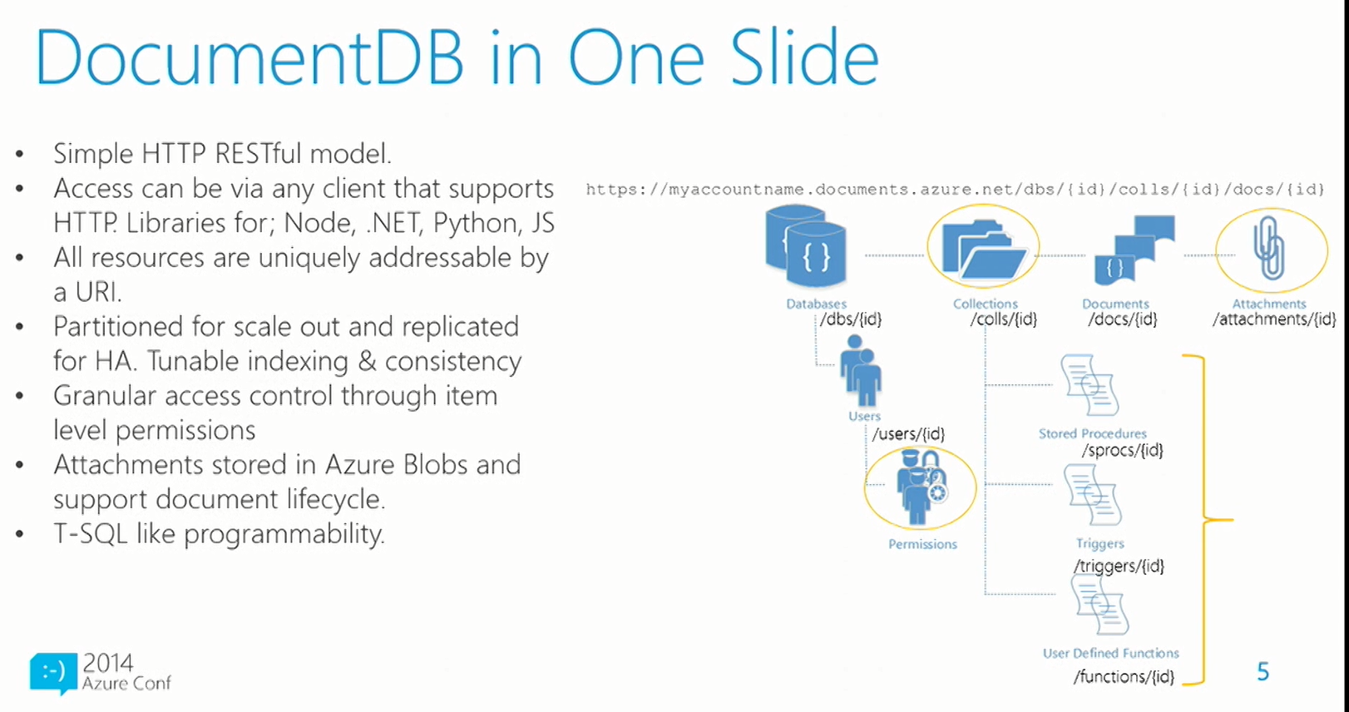

Slide 18
Example JSON Document
{
"_id" : “1000”
"Title": "What's new in DocumentDB",
"Content" : " DocumentDB 1.0 represents hundreds of improvements and features driven by user requests...",
"Author" : {
"FirstName" : "David",
"LastName" : "Green"
},
"Comments" : [],
"Tags" : [
"C#",
".NET",
"NoSQL",
"MongoDB"
]
}

Slide 19

Agenda
Introduction
Azure, NoSQL & DocumentDB
Getting Started (Setup in Azure)
Working with DocumentDB (C#)
Cost/usage
Uses cases & limitations of DocumentDB
This is no cave… ~ Han Solo

Slide 20

Setup In Azure
Live Demo Edition!

Slide 21
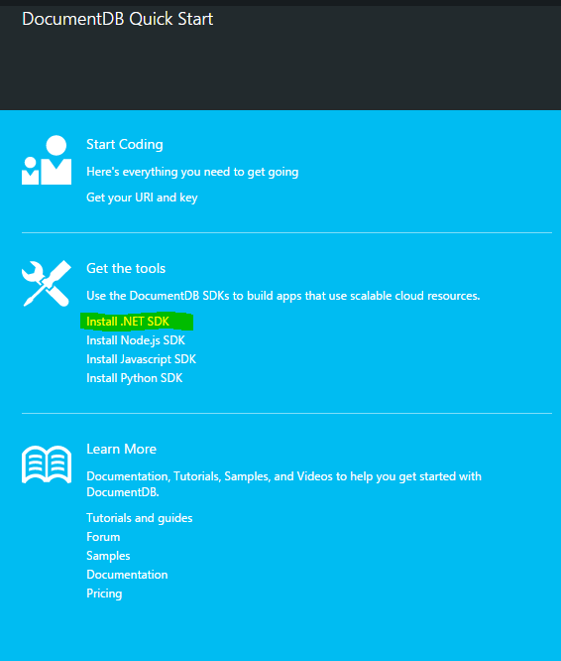
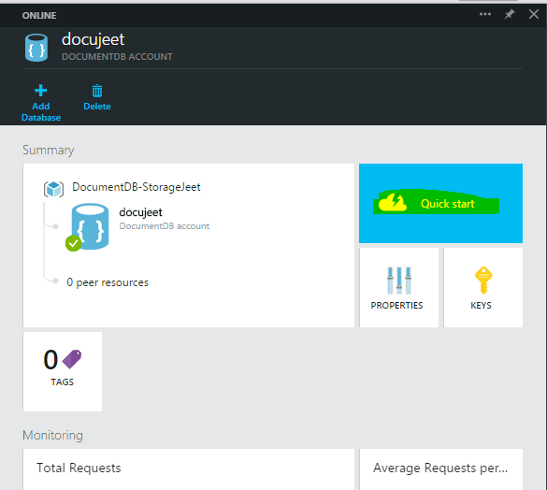
For Developers…

Slide 22
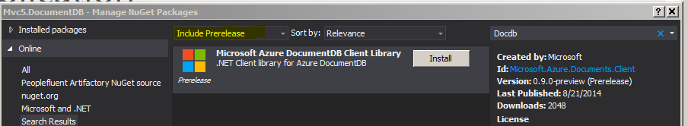
For Developers (cont)…

Slide 23


Agenda
Introduction
Azure, NoSQL & DocumentDB
Getting Started (Setup in Azure)
Working with DocumentDB (C#)
Cost/usage
Uses cases & limitations of DocumentDB
I am altering the deal. Pray I don't alter it any further. ~ Darth Vader
Notes:
If they had developers, they’d be this guy. Actually, the wireless headset…

Slide 24

Basic CRUD:
Create
Read
Update
Delete
Advanced Topics:
Indexes
Consistency
Programmability
UDFs
Triggers
Stored Procedures

Slide 25
Indexing in DocumentDB
By default everything is indexed
Indexes are schema free
Indexing is not a B-Tree and works really well under write pressure and at scale
Out of the Box. It Just Works.

Slide 26
Tuning Consistency
Database accounts are configured with a Default consistency level. Consistency level can be weakened per read/write request.
Four consistency levels
STRONG – all writes are visible to readers. Writes committed by a majority quorum of replicas and reads are acknowledge by the majority read quorum.
BOUNDED STALENESS – guaranteed ordering of writes, reads adhere to minimum freshness. Writes are propagated asynchronously, reads are acknowledged by majority quorum lagging writes by at most N seconds or operations (configurable).
SESSION (Default) – read your own writes. Writes are propagated asynchronously while reads for a session are issued against the single replica that can serve the requested version.
EVENTUAL – reads eventually converge with writes. Writes are propagated asynchronously while reads can be acknowledged by any replica. Readers may view older data than previously observed.
Notes:
Usually when you issue a write, you are writing to one machine in the cloud. That machine then replicates. There is a lag between the time it takes to replicate from the machine to the others.

Slide 27
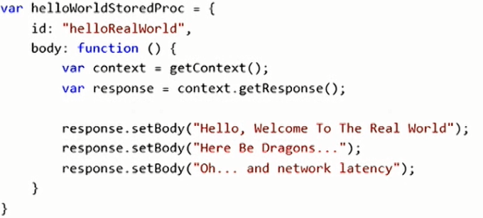
Programmability in DocumentDB
Familiar constructs
Stored procs, UDFs, triggers
Transactional
Each call to the service is an ACID transaction
Uncaught exception to rollback
Sandboxed
No imports
No network calls
No Eval()
Resource governed & time bound

Slide 28
Where to Use Programmability?
Reduce Network Calls
Bulk Insert
Multi-Document Transactions
Each call in ACID transaction
No multi-statement transactions (i.e. One REST call = One transaction)
Transform & Join
Pull content from multiple documents. Perform calculations
JOIN operator intradoc only

Slide 29

Agenda
Introduction
Azure, NoSQL & DocumentDB
Getting Started (Setup in Azure)
Working with DocumentDB (C#)
Cost/usage
Uses cases & limitations of DocumentDB
“Ben…” – Luke Skywalker
Notes:
If they had developers, they’d be this guy. Actually, the wireless headset…

Slide 30
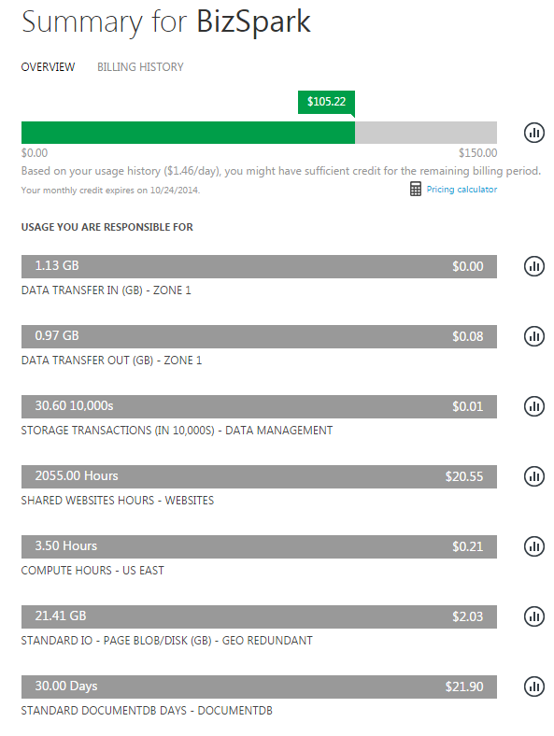
COSt
Notes:
30 days, low usage at 1 CU (Capacity Unit) ~ US $22

Slide 31
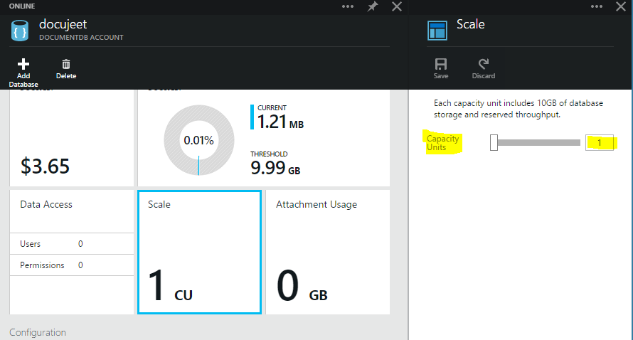
Capacity UNITS
“Each CU comes with 3 elastic collections, 10GB of SSD backed provisioned document storage and 2000 request units (RU) worth of provisioned throughput. The provisioned storage and the throughput capacity associated with a CU is distributed across the DocumentDB collections you create”
Notes:
30 days, low usage at 1 CU (Capacity Unit) ~ US $22

Slide 32
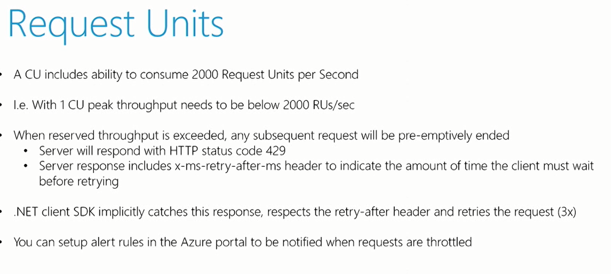
Notes:
“A single DocumentDB database can contain practically an unlimited amount of document storage partitioned by collections. Collections form the transaction domains for the documents contained within them. A DocumentDB database is elastic by default – ranging from a few GB to potentially petabytes of SSD backed document storage and provisioned throughput. Unlike a traditional RDBMS database, a database in DocumentDB is not scoped to a single machine.”
Note that in the Preview release the collections can grow and shrink anywhere between 0-10GB.

Slide 33
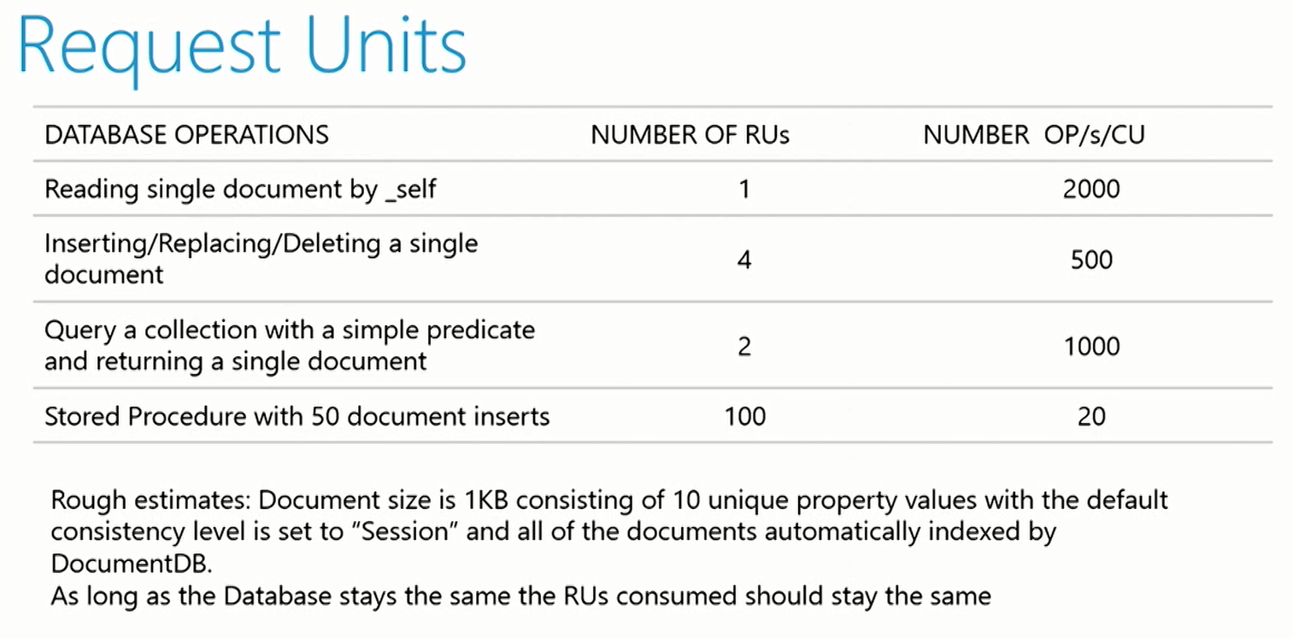
Notes:
Show a demo using the Github explorer and look at request headers

Slide 34

Agenda
Introduction
Azure, NoSQL & DocumentDB
Getting Started (Setup in Azure)
Working with DocumentDB (C#)
Cost/usage
Uses cases & limitations of DocumentDB
Original iWatch prototype
“I've just made a deal that'll keep the Empire out of here forever.” ~ Lando Calrissian

Slide 35
When to use DocumentDB
General Principle 1:
Know your use case. Do not force fit a technology for a problem. Rather, choose the technology that best aligns with solving your problem.
General Principle 2:
Figure out the operation(s) you do the most and optimize for those cases. If you have an existing product, gather metrics about current usage patterns (e.g. reads/writes per second) to help guide you.

Slide 36
DocumentDB Use Cases
Document Management systems
E-commerce (catalog portion only)
Archiving / event logging
Real time analytics (based on logging)
Gaming
Mobile

Slide 37


Slide 38

Dwight Merriman: Founder and chairman of MongoDB, the fastest growing database platform in the world. MongoDB has a estimated valuation of 1.2 billion dollars.
Me: Founder of nothing significant.
With my mortgage I have a negative net worth.
Darth Vader (me): What is thy bidding, my master?
Emperor (Dwight): There is a great disturbance in the Force.
Darth Vader: I have felt it.
Me: What do you think of Microsoft DocumentDB?
Dwight: I haven’t really looked at it.
Me: Oh, so your not worried about a competitor?
Dwight: Well it’s Microsoft…(just laughs)

Slide 39
Limitations
Document size limits (originally 16KB, but now 256KB)
No local version
Missing certain fundamental constructs (e.g. ORDER BY)
Support for aggregate fxns (e.g. Group BY)
No tooling (okay, okay…lame tooling)
Forum For links and suggestions: http://feedback.azure.com/forums/263030-documentdb
Ayende’s Review:
http://ayende.com/blog/168034/azure-documentdb
Comparing DocumentDB with MongoDB: http://daprlabs.com/blog/blog/2014/08/22/azure-documentdb/

Slide 40

Questions?

Slide 41
The End

Slide 43
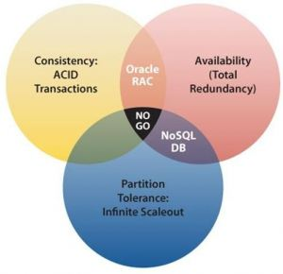
CAP Theorem
Consistency All nodes see the same data at the same time.
Availability A guarantee that every request receives a response about whether it was successful or failed.
Partition tolerance The system continues to operate despite arbitrary message loss or failure of part of the system.

Slide 44
